Slide 1
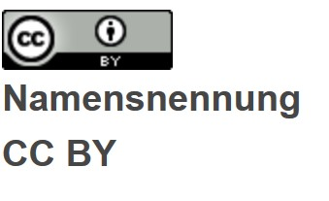
Open competence center for
designing lessons in a digital age

Slide 2
What is digital.learning.lab about?

Slide 3
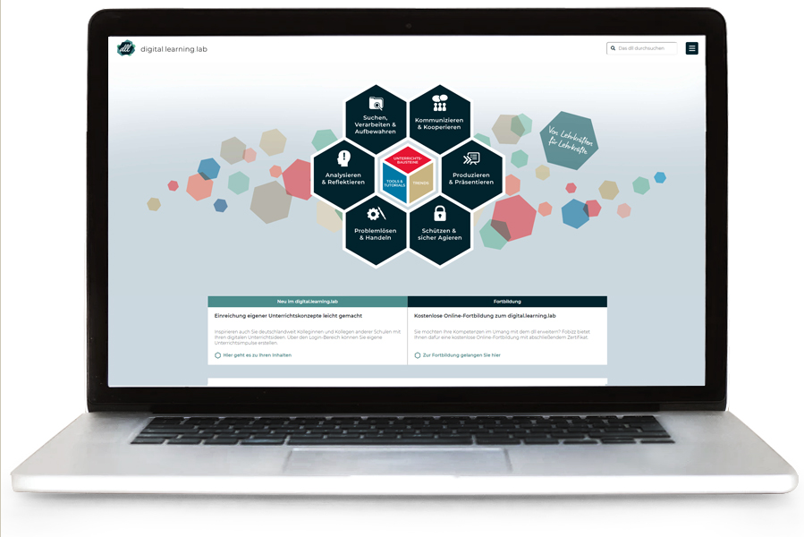
digital.learning.lab
is an open competence center for teaching design in a digital age.
The digital.learning.lab is a co-operation of Hamburger Behörde für Schule und Berufsbildung, Hamburg University of Technology and Joachim Herz Foundation .

Slide 4
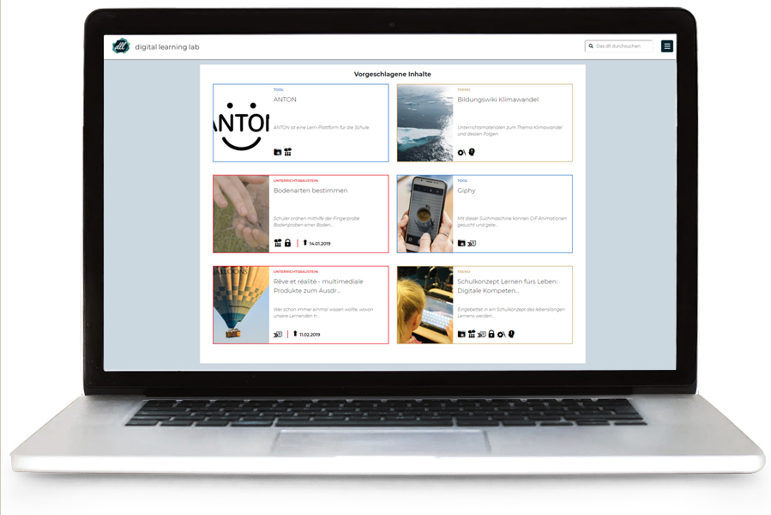
How does digital.learning.lab work?
Teachers find suggestion and support to design their lessons, taking into account the competences for a digitized world.

Slide 5
What are the reasons to use digital.learning.lab?
Quality assured impulses for lesson design
Impulses across competences defined by KMK
Free of charge and without registration
Usable without prior knowledge
For all subjects and grades
Open Education Resources (OER)
Personalized feedback on teaching concepts

Slide 6
How is digital.learning.lab structured?

Slide 7
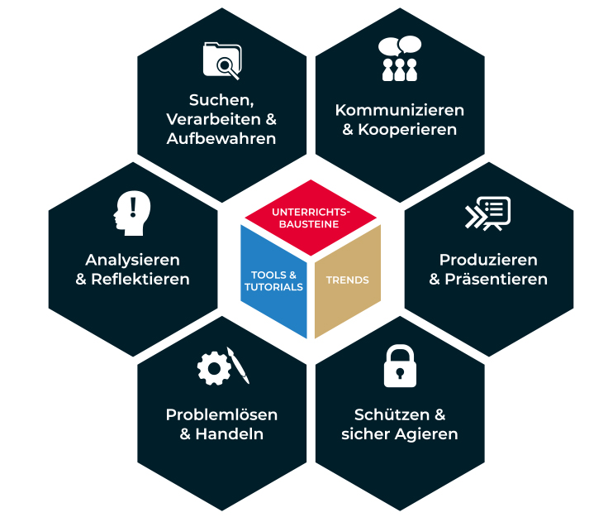
Structure
Six Competences The content is assigned to the corresponding competences defined by KMK for education in a digital world
Content for Lessons Find digital examples of teaching situations you can utilize for your lessons
Tools & Tutorials Find out more about tools and their functionalities for school education Trends Find publications, projects and other ideas for education in a digital world

Slide 8
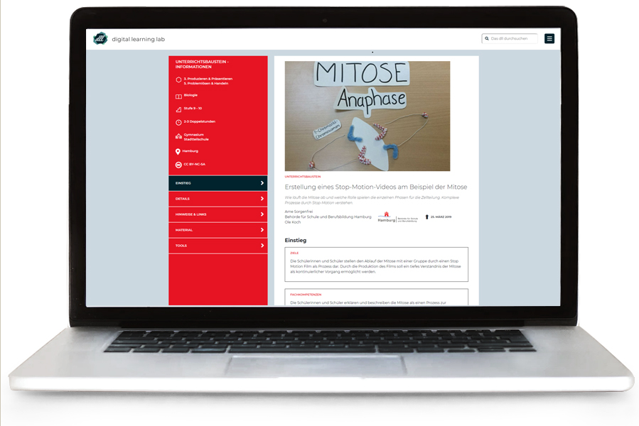
Content for lessons
Model for content access:
Access Layer 1: Overview goals, professional skills, competences in a digital world, media equipment
Access Layer 2: Details subject, description, reference to education plan, individualization
Access Layer 3: Hints & Links notes, literature/ links, media

Slide 9
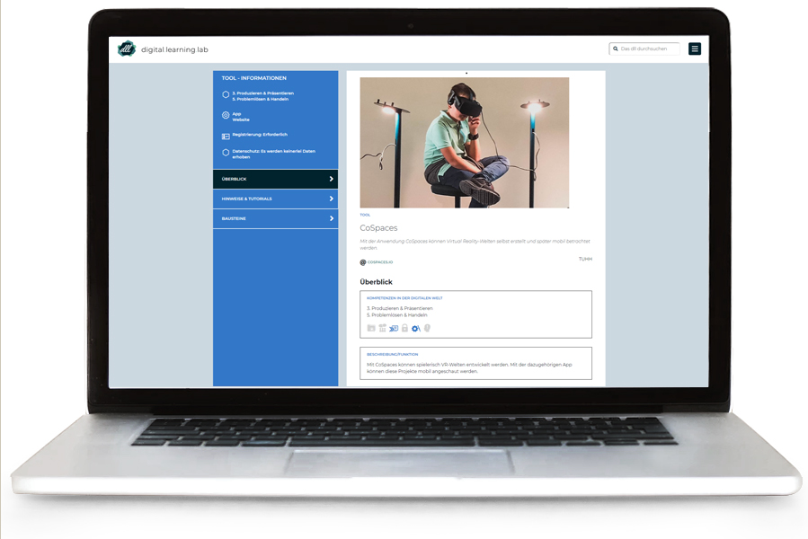
Tools
Model for content access:
Access Layer 1: Overview functionalities, operating system, pros and cons, competences in a digital world, application type
Access Layer 2: Hints & Tutorials Registration, usage, hints, age restrictions
Access Layer 3: Simular Tools Alternatives

Slide 10
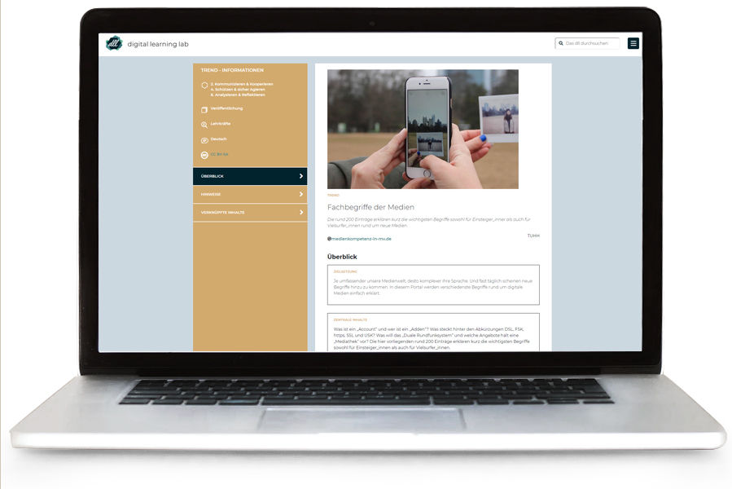
Trends
Access Layer 1: Overview objectives, central topics, competences in a digital world
Access Layer 2: Hints background, further literature and links

Slide 11
How to share content

Slide 12
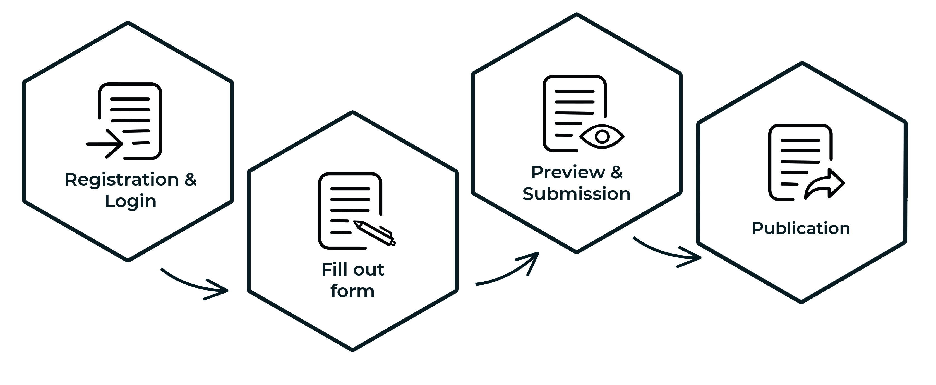
How to share content
Teachers can publish content for designing lessons with ease.
Why share content?
Receive support with developing your own digital teaching design
Peer feedback on your design
Learn with, and from other teachers about lesson development

Slide 13
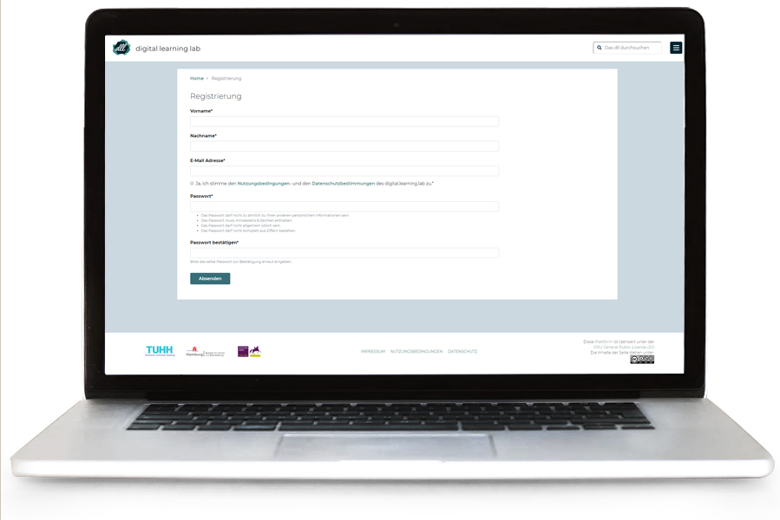
Registration
In order to contribute your own content, it is necessary to create a user account.
A user account can be created in the "Login" area under the "Registration“ button.
After confirming the e-mail address, access to the "Login" area is possible.

Slide 14
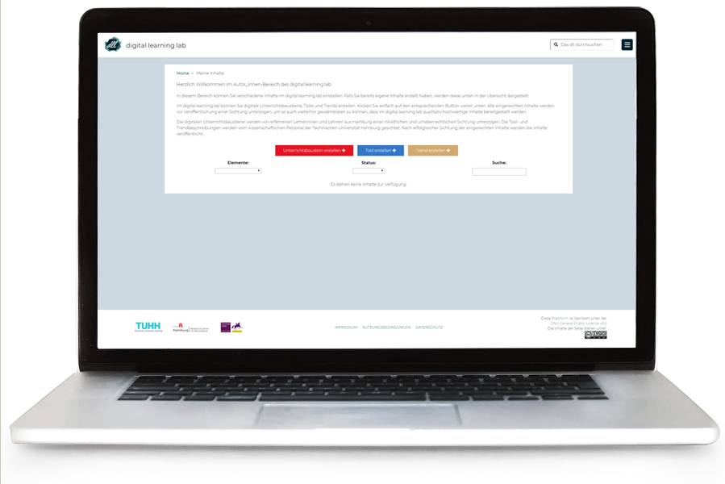
Creation & Submission
In the “My Content“ section you can create content for lessons, tools and trends.
If all mandatory fields have been filled in, the content can be submitted for content and copyright viewing.

Slide 15
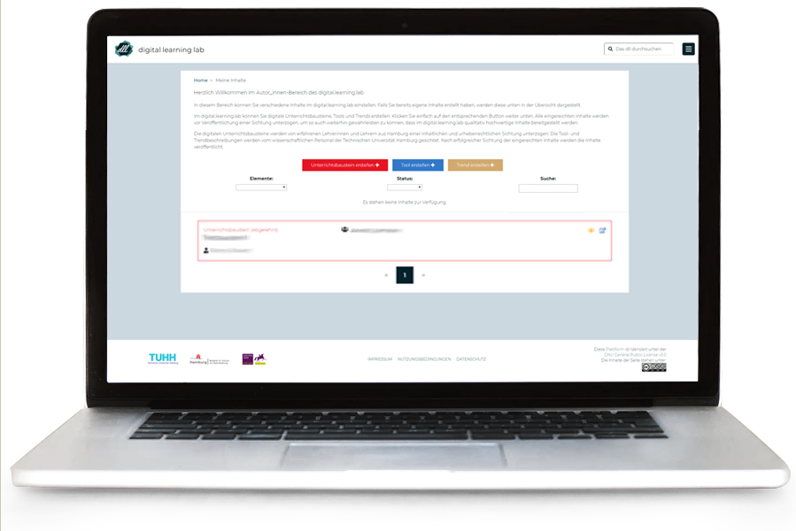
Analysis & Possible Feedback
After being analysed by experienced educational staff, the content is published.
In the case of revision requests, an e-mail is sent with feedback.

Slide 16
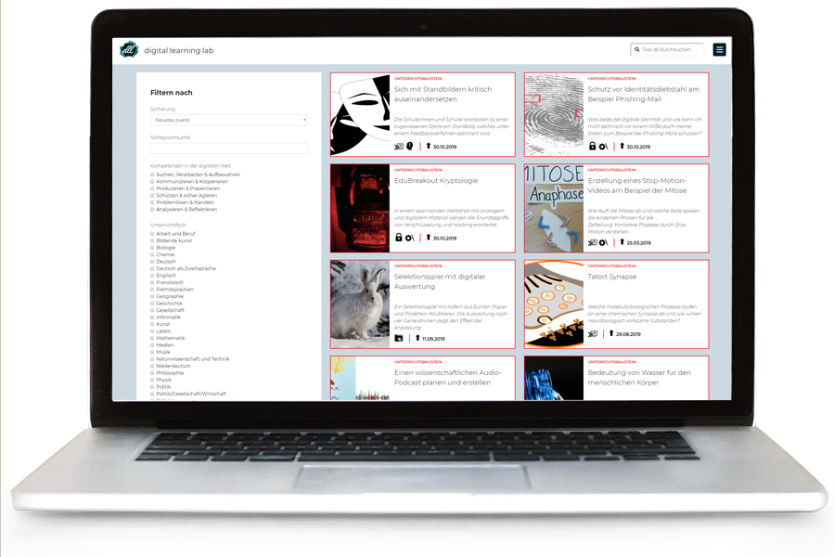
Publishing
After successful analysis, your content will be published.

Slide 17

Contact
Ronny Röwert
Institute of Technical Education and University Didactics
digital.learning.lab@tuhh.de
@digilearninglab

